Slide 1
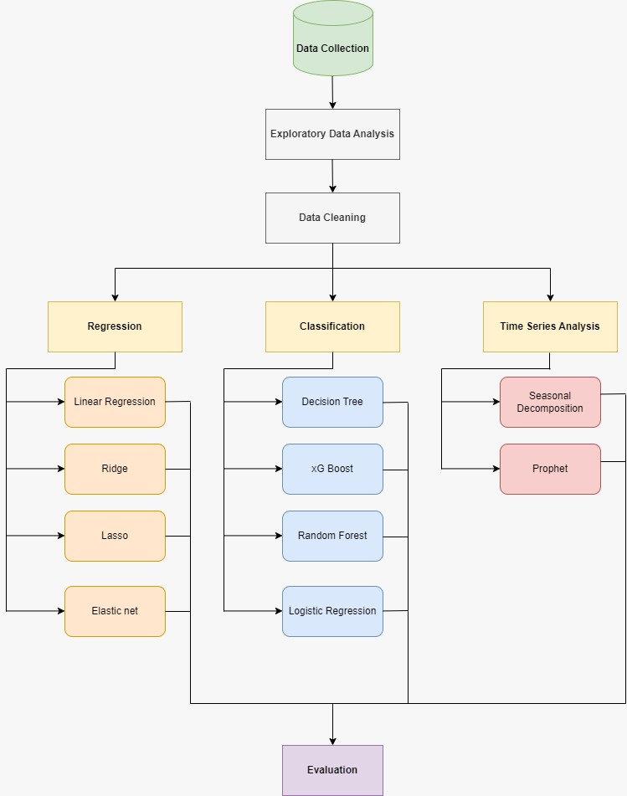
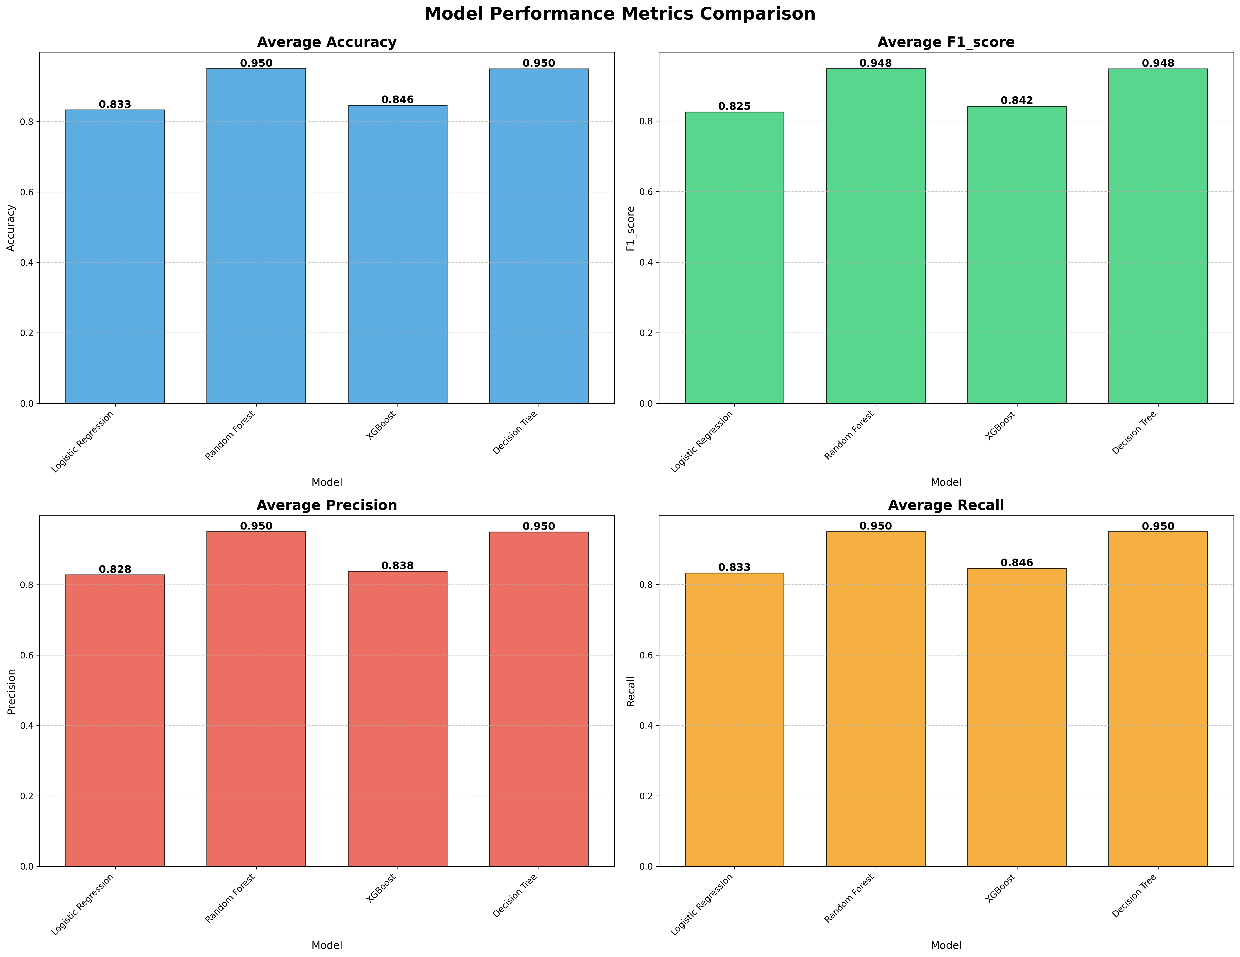
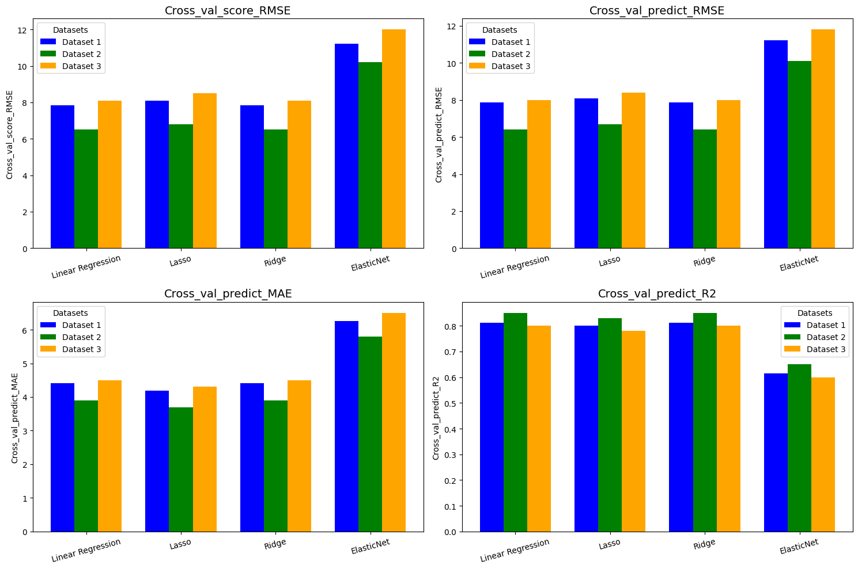
Introduction
Efficient transportation systems are the backbone of urban economies.
Increasing population density leads to traffic congestion and fluctuating ride demands.
NYC heavily relies on its diverse modes of transit, including taxis subways and rideshares.
Motivation
Understanding how transportation operates can improve urban mobility and reduce inefficiencies.
Predicting fares dynamics, transportation patterns and passenger’s behavior can help optimize resource allocation
Insights from this study can support sustainable urban planning and smart transit systems.
Questions?
Can we predict fair amount based on other features like trip distance, passenger count, etc?
Can we predict payment type based on other features?
Can we forecast future demand and revenue based on past data?
Predictive Modeling and Machine learning Insights from NYC Taxi Data
Results
Ridge seems to be the most consistent performer on regression across all datasets, particularly in terms of balancing RMSE, MAE, and R².
Random Forest and Decision Tree consistently perform the best across all metrics, scoring 0.950 in accuracy, precision, and recall, and 0.948 in F1 score.
Prastut Dahal,
Ujjwal Kuikel,
Dipika Bogati

Slide 2
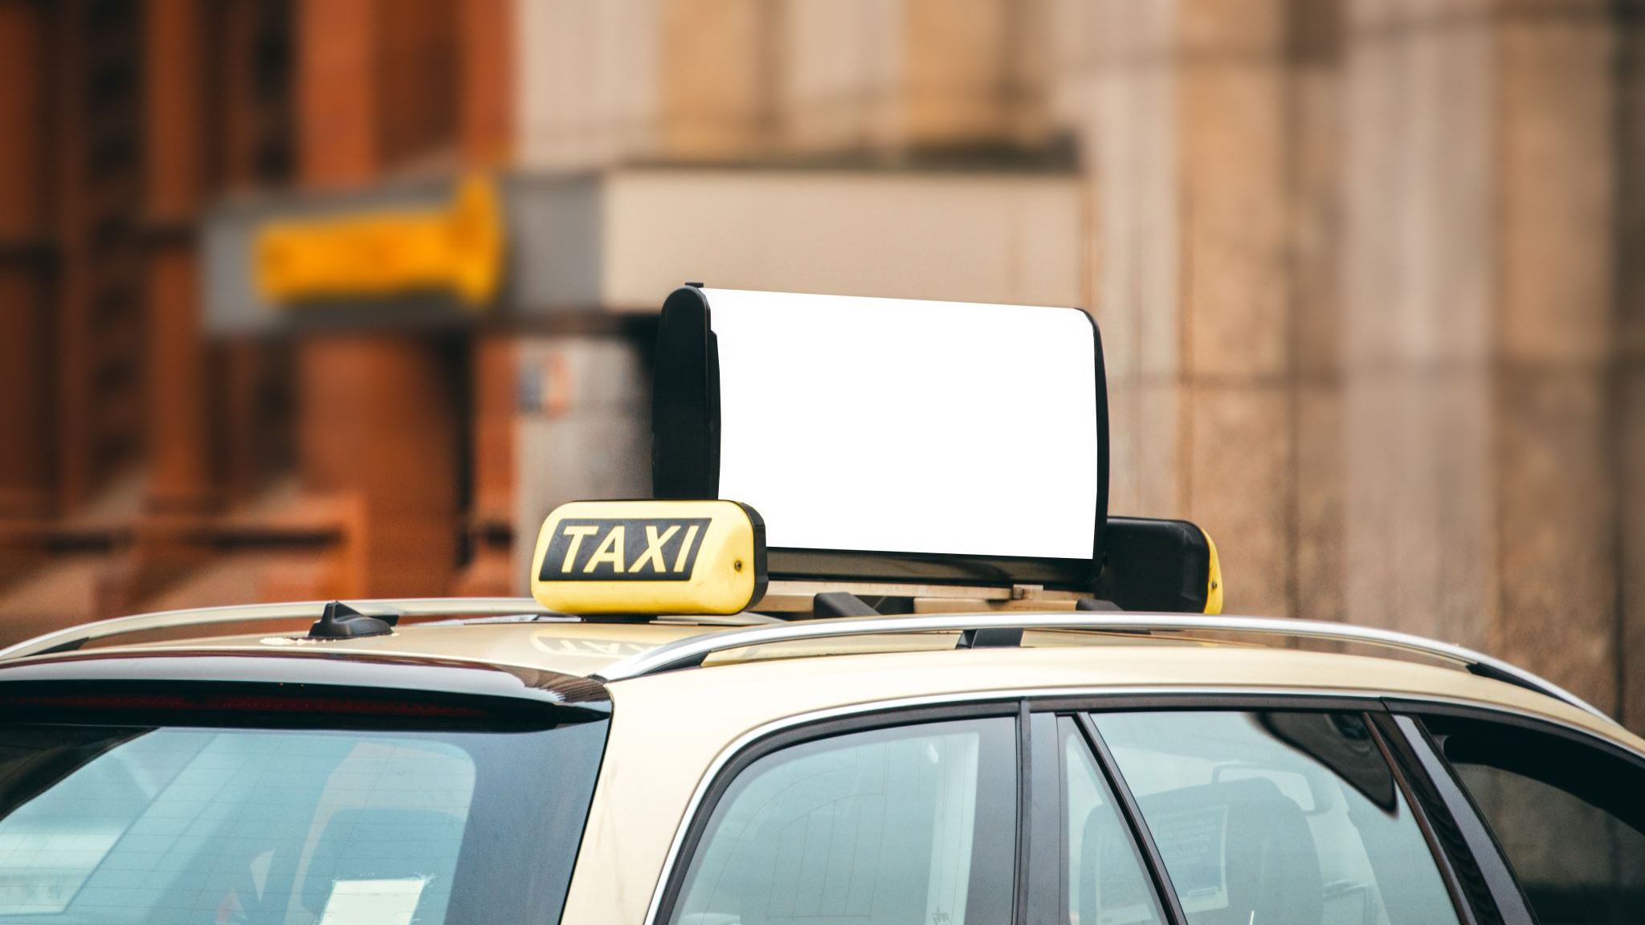
Predictive Modeling and Machine Learning Insights from NYC Taxi Data
Prastut Dahal
Dipika Bogati
Ujjwal Kuikel

Slide 3

Introduction
Efficient transportation systems are the backbone of urban economies.
Understanding how transportation operates can improve the mobility and reduce inefficiencies
Predicting fares dynamics, transportation patterns and passenger’s behavior can help optimize resource allocation
Insights from this study can support sustainable urban planning and smart transit systems.

Slide 4
Questions we answered
Can we predict fair amount based on other features like trip distance, passenger count, etc?
Can we predict payment type based on other features?
Can we forecast future demand and revenue based on past data?

Slide 5
Methodology

Slide 6
Dataset
Source:
NYC Taxi & Limousine Commission (TLC) Yellow Taxi Trip Records
Open dataset with millions of trip records from NYC taxis
Key Features:
Trip Details: Pickup and drop-off locations, timestamps, trip distance
Fare Information: Total fare, tip amount, payment type
Passenger Data: Number of passengers per trip
Time-Related Attributes: Pickup time, dropoff time

Slide 7
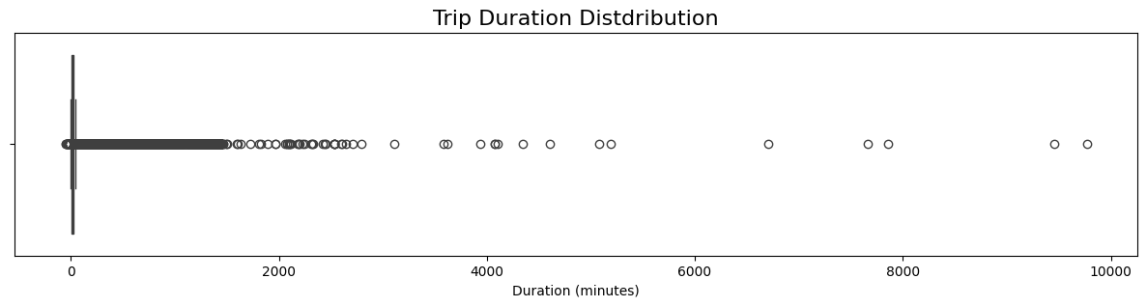
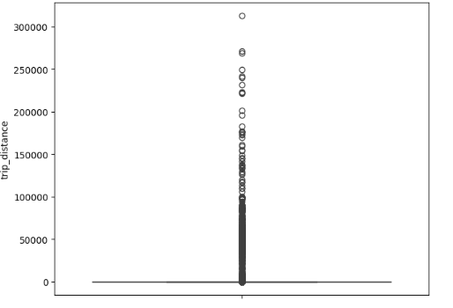
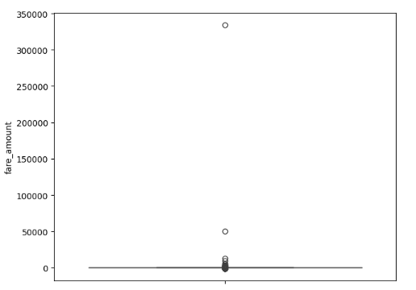
EDA

Slide 8
Data Cleaning
Handling Missing Data:
Checked for missing values and imputed or removed rows/columns as needed.
Feature Engineering:
Created new features (e.g., trip_duration, hour_of_day, day_of_week) based on raw data.
Encoded Categorical Variables:
Used one-hot encoding or label encoding for categorical data.
Handled Duplicates:
Checked for and removed duplicate rows to avoid skewing results.
Outlier Detection and Removal:
Identified and removed outliers in numerical features (e.g., extreme trip fares, durations).

Slide 9
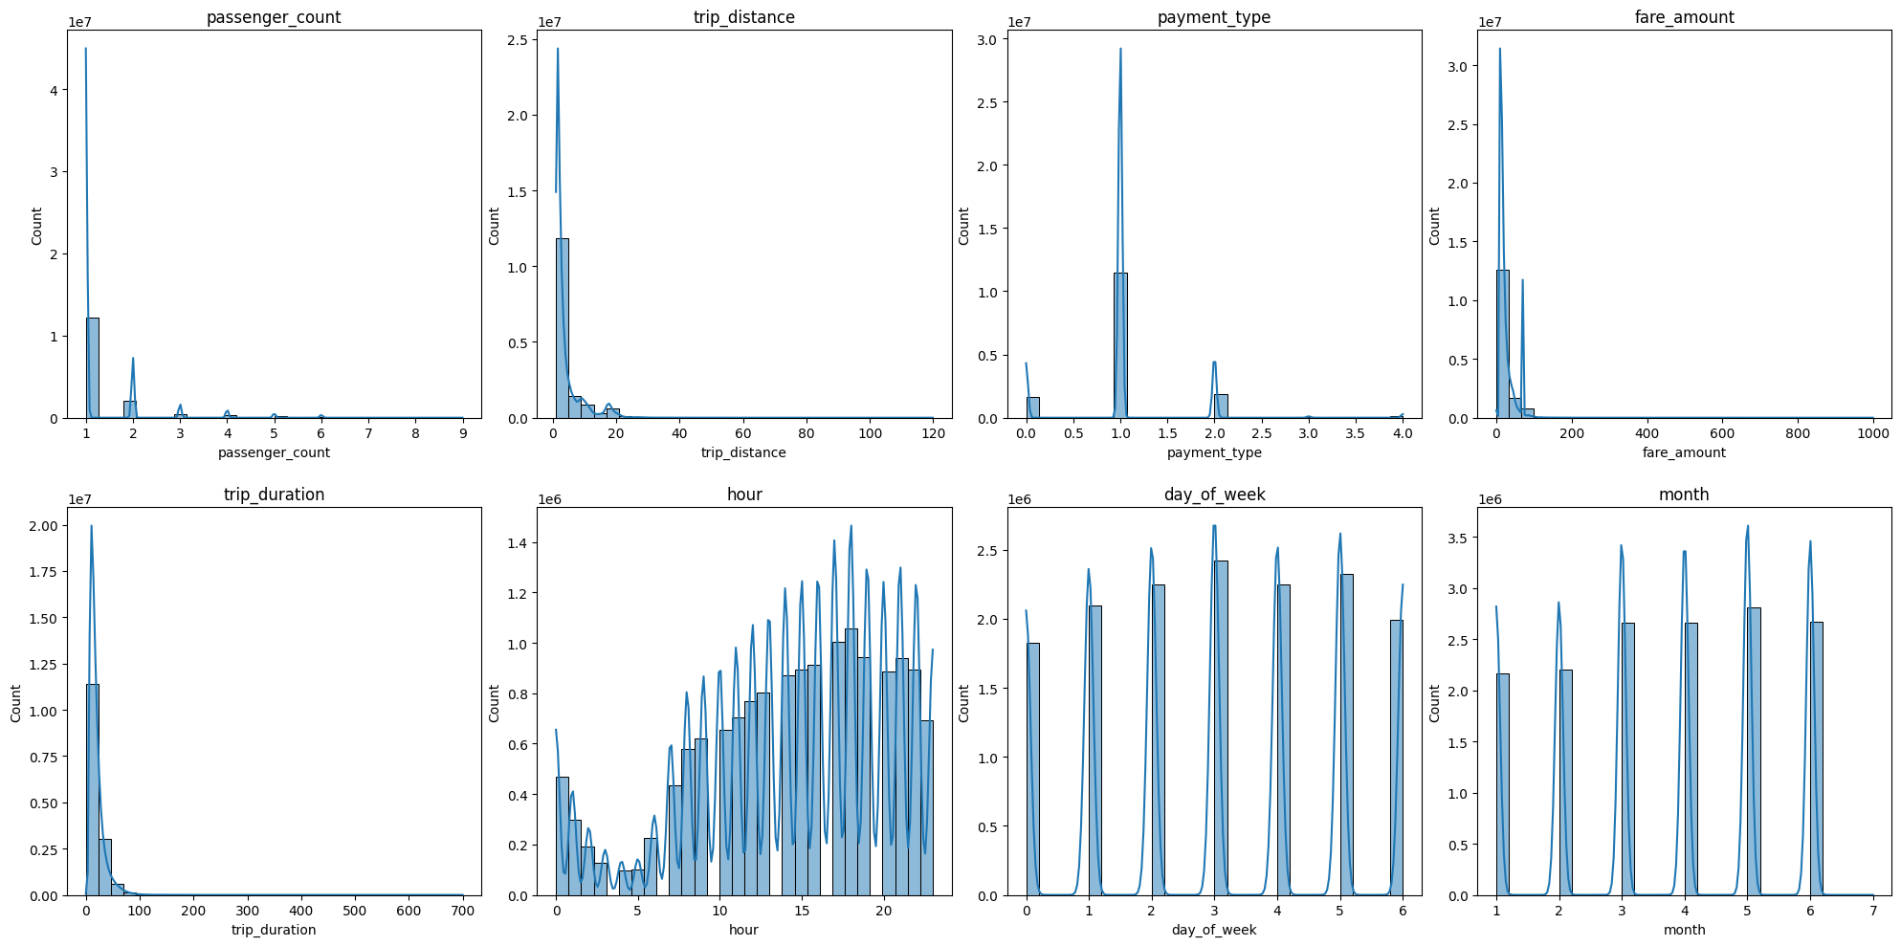
EDA

Slide 10
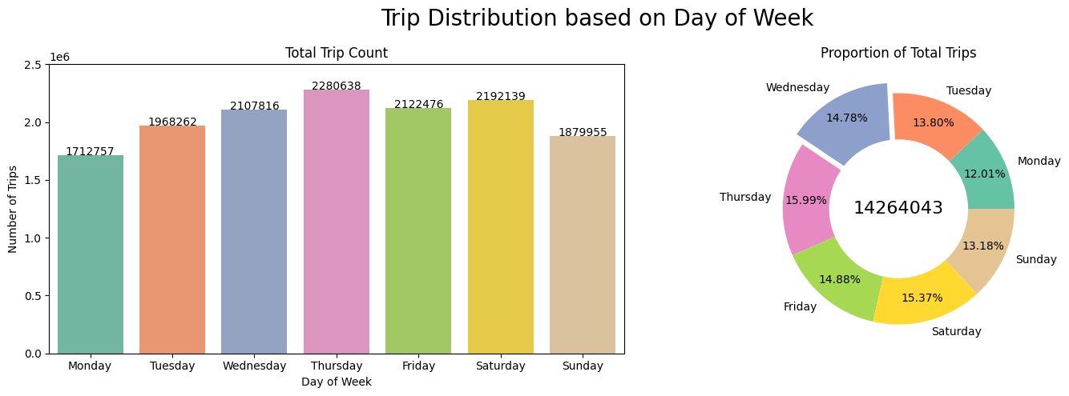
Trip Distribution on Day of Week

Slide 11
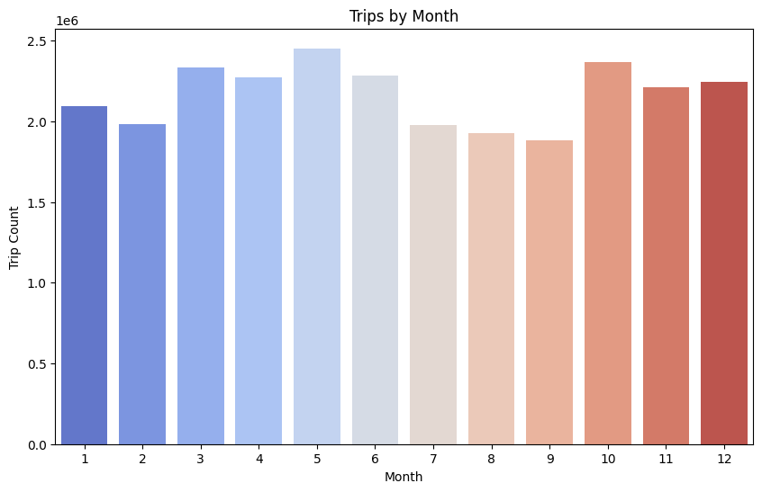
Trips By Month

Slide 12
Regression
Linear Regression:
Fits a straight line that best represents the linear relationship between features and target.
Lasso Regression:
Uses L1 regularization to perform feature selection by driving some coefficients to zero.
Ridge Regression:
Applies L2 regularization to prevent overfitting by shrinking coefficients.
Elastic Net:
Combines L1 and L2 regularization for balanced feature selection and coefficient shrinkage.
Notes:
Linear Regression:
Assumes a linear relationship between independent and dependent variables, fitting a straight line that minimizes the sum of squared residuals.
Lasso Regression:
Applies L1 regularization by adding absolute value of coefficients to the loss function, effectively performing feature selection by driving some coefficients to zero.
Ridge Regression:
Uses L2 regularization by adding squared magnitude of coefficients to the loss function, which helps prevent overfitting by shrinking coefficients close to zero.
Elastic Net:
Combines both L1 and L2 regularization, providing a balanced approach that performs feature selection like Lasso while maintaining the coefficient shrinkage properties of Ridge regression.

Slide 13
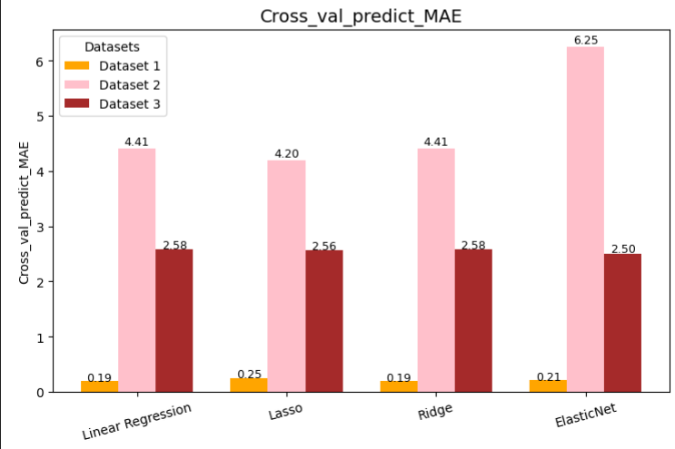
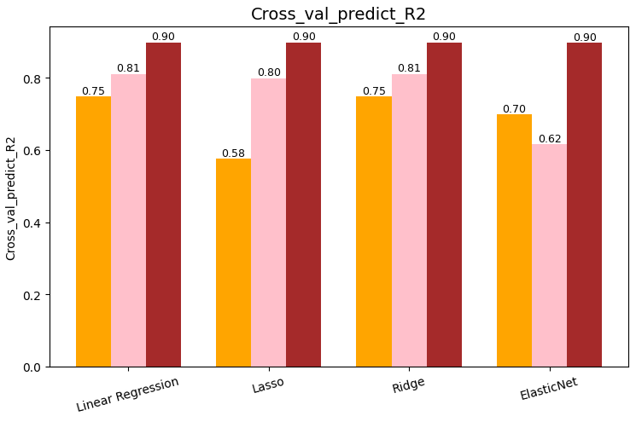
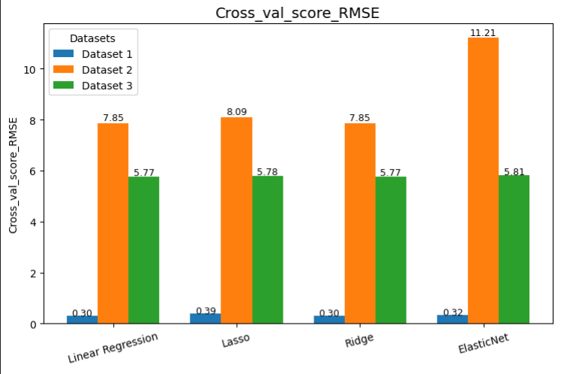
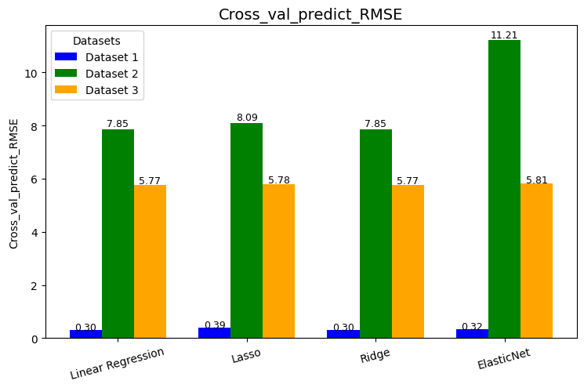
Evaluation
Notes:
Linear Regression and Ridge dominate across all datasets, showing consistently low RMSE, MAE, and high R² scores, making them the most reliable models overall.

Slide 14
Classification
Logistic Regression: ​
Assumes there is linear relationship between features and target values, using a sigmoid function to transform linear combinations into probabilities.
Decision Tree:​
Captures both linear and non-linear relationships by hierarchically splitting data based on feature importance, creating a tree-like model of decisions.​
Random Forest:​
Combines multiple decision trees to make better predictions by using bootstrap aggregation and reducing overfitting through tree diversity.​
XGBoost:​
Unlike random forest, it creates one decision tree at a time, with each tree strategically designed to fix the mistakes from the previous tree using gradient descent.

Slide 15
Average Accuracy

Slide 16
F1_Score

Slide 17
Precision

Slide 18
Recall

Slide 19
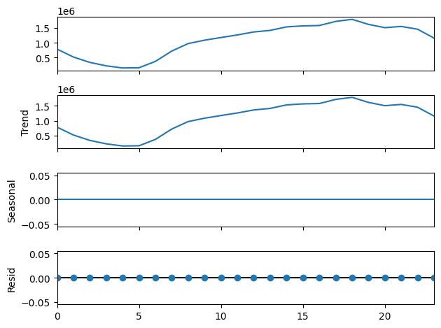
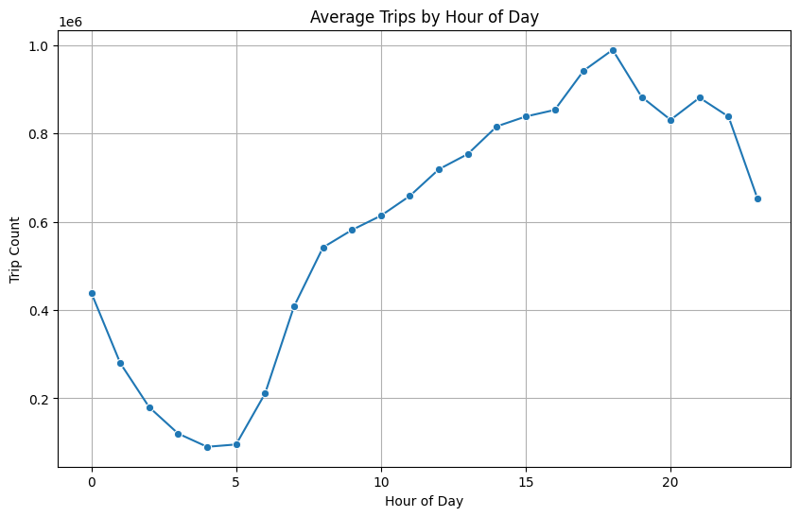
Hourly Demand

Slide 20
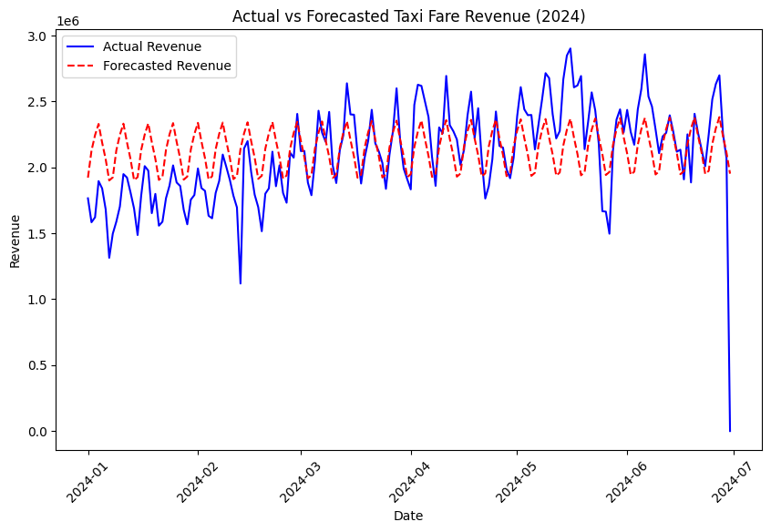
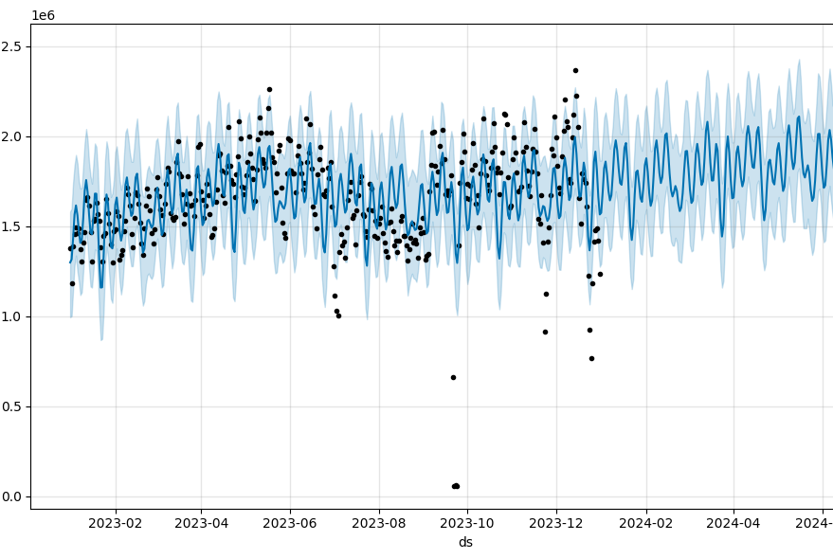
Actual vs Forecasted Fare Revenue

Slide 21
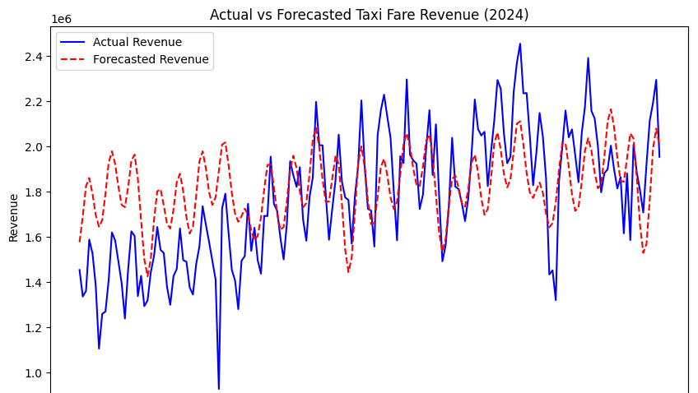

Slide 22
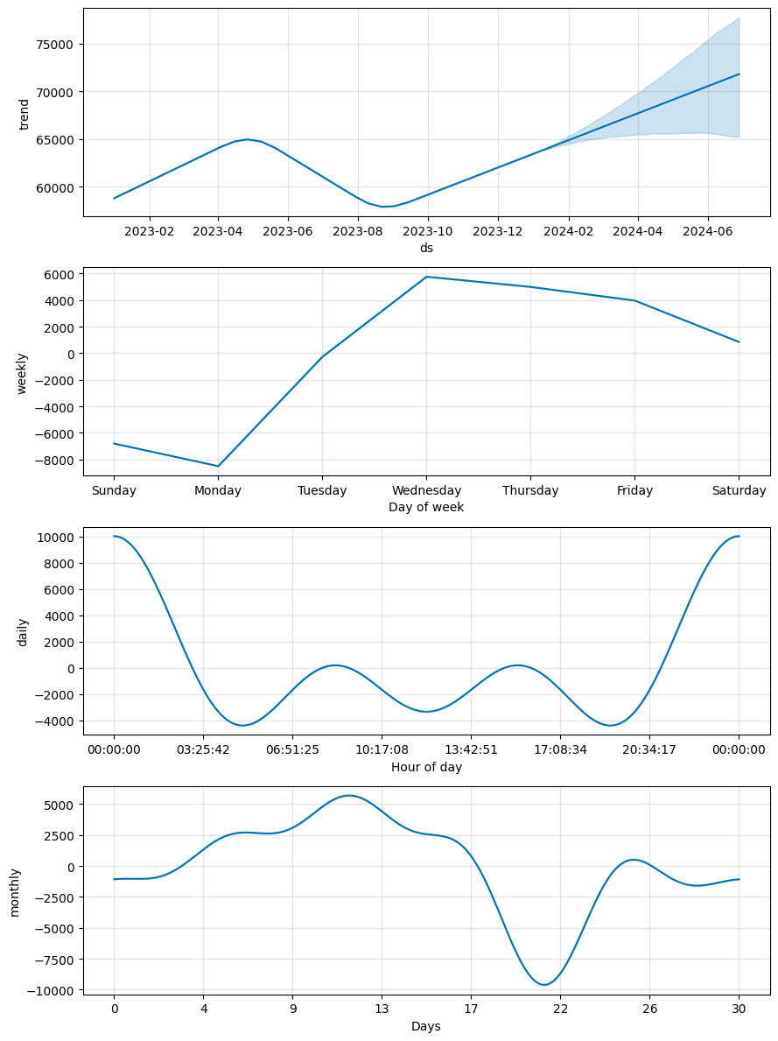
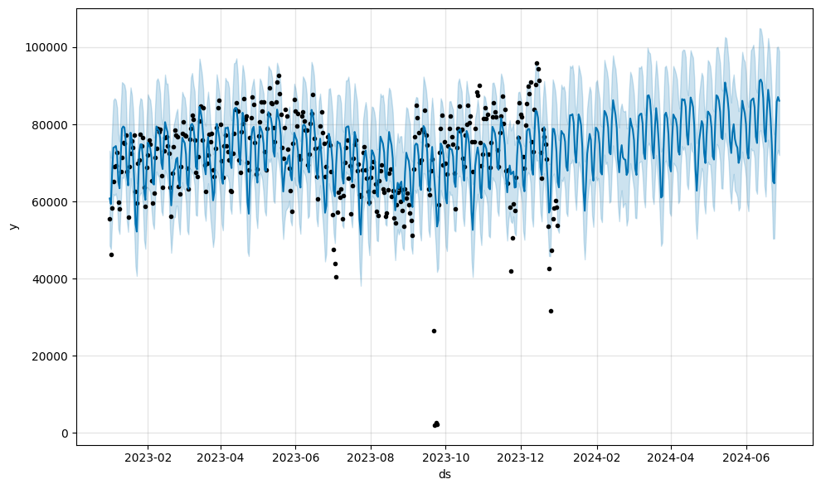
Taxi Demand

Slide 23
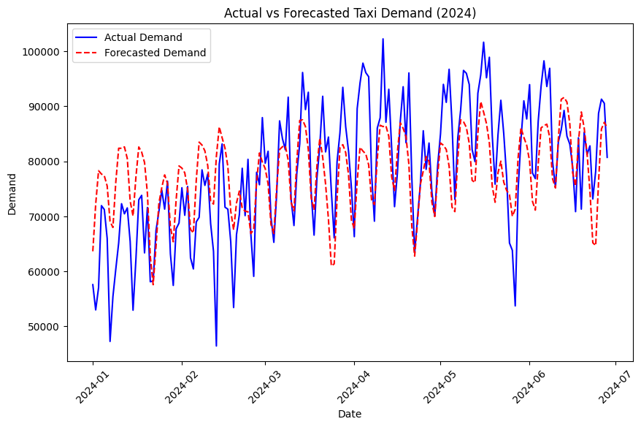
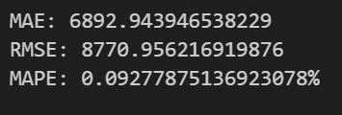
Actual vs Forecasted Taxi Demand

Slide 24
Conclusion
To conclude, we effectively predicted fare amount, payment types and also future revenue and demand.
Predictions help enhance efficiency and customer experience.
Results validate the potential of regression and classification models in transportation data analysis.
Future work can include exploring more advanced models and deep learning for higher accuracy.
Also, Develop real-time prediction models to handle dynamic changes in demand and improve decision-making.

